Slide 1
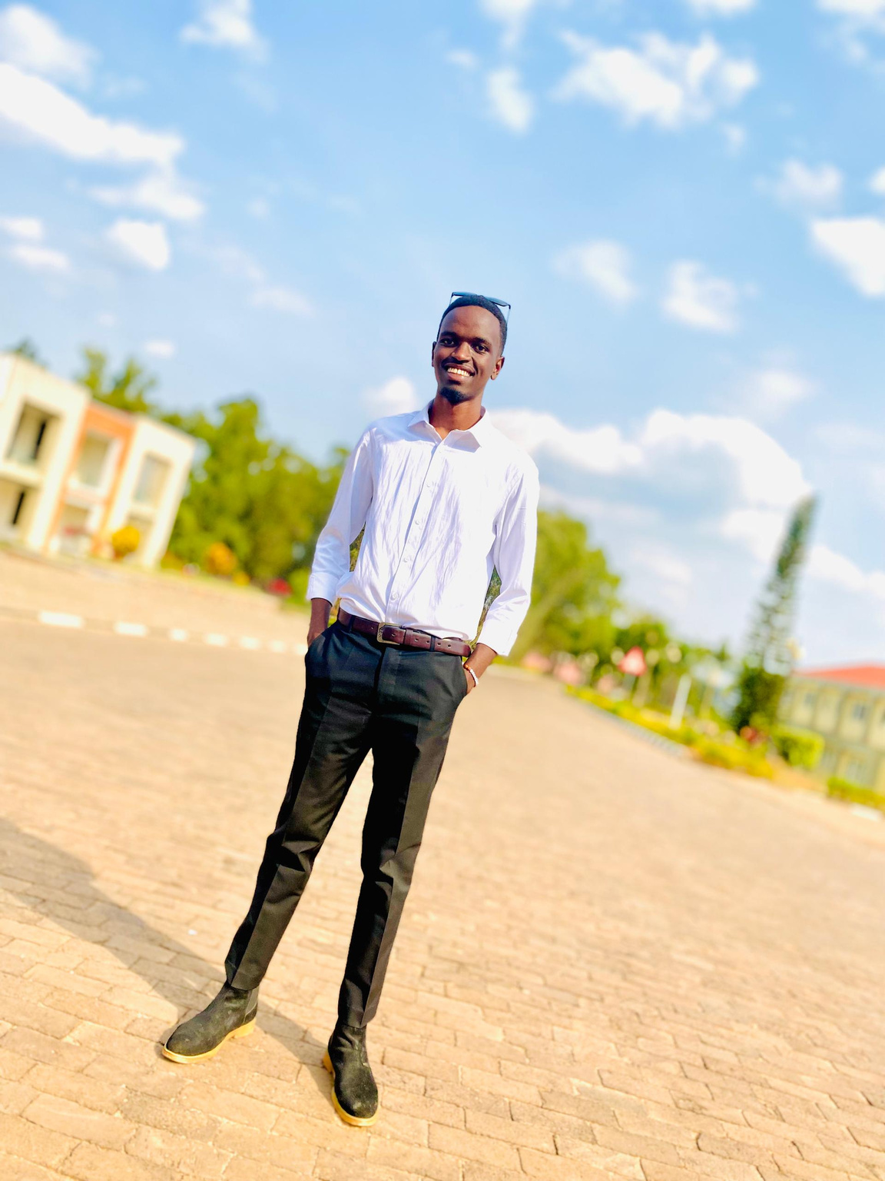

Steven ISHIMWE
https://www.linkedin.com/in/steven-ishimwe-mutsinzi/
I’M CURRENTLY STUDYING INFORMATION MANAGEMENT
Education:
Current Year of Study: 3rd Year Student
Location: Rubavu District, Rwanda
Digital Skills:
Proficient in SPSS for data analysis.
Extensive experience with Microsoft Office tools (Excel, Word, PowerPoint) for academic and professional tasks.
Knowledge of various programming languages used in projects and coursework.
EXPECTATIONS:
I’m expecting to become a Database Administrator at the end of this course , with a focus on managing and optimizing data systems.

